Slide 1
Probability and Probability distributions
Day 2
2016

Slide 2
Topics
What is probability?
An example – Minesweeper
Rules of probability and Bayes theorem
An example – Bayes theorem demo
Frequentist vs. Bayesian probability
Random variables and probability distributions
Normal and binomial distributions with examples
Population and sample
Sampling distributions and CLT
An exercise – CLT
Demo of CLT [Why Normal distribution is so important]

Slide 3
What is probability
Notes:
Ask for definitions of probability from students [10 minutes]
Discuss the differences between their definitions – Prompt them to go from vague definitions of how ‘likely’ something is to something more specific
Talk about how the usual definition of prob – favourable outcomes/ total outcomes assumes ‘equal chance’ of each outcome

Slide 4
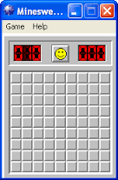
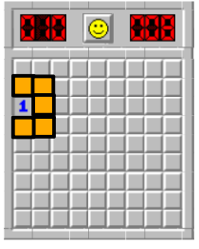
Let’s play Minesweeper
What is the probability of not hitting a mine in the first click?
Should you choose an orange or non orange cell?
Notes:
Play minesweeper [10 minutes]
Either use the slide to play minesweeper or actually open Minesweeper on their laptops
Prompt them to make decisions based on probability [Help build intuition about how probability is important in decision making under uncertainty]
Answer questions detailed in the slide. Can make use of the board to solve the questions along with them through an interactive Q & A
Where do you use probability in daily life?
Should I carry an umbrella?
Will people turn up for a meeting?
You want to invest in the stock market? How do you evaluate stocks which will go up in price?
Poker hands/ Horse races/ Bets
Drive a discussion around the point that we intrinsically use probability in every day life. This is a formalization of the concept
Can we do away with probability?
Relate back to the first session – Inferring from a small sample to population
Decision making under uncertainty [Look at the govt. example Session 1 Slide 1 Notes]
Have a discussion on this – Cite examples from business and their downstream decisions:
What is the probability that a customer will churn?
Marketing campaign – Did the campaign really improve sales?
What is the probability that demand for a product will be at a particular level?
Introduce the idea of odds = Favourable outcomes/ non-favourable outcomes. Talk about how it is easier to understand in that it is not bounded from 0 to 1.

Slide 5

Independence and mutual exclusivity
What is the probability of hitting a mine and not hitting a mine?
What is the probability of hitting a mine and choosing square A1?
These are mutually exclusive events. They both cannot happen simultaneously.
0
These are independent events. One does not affect the other.
Some additional laws of probability
What is the probability of opening cell A1?
For any event A, P(A) ≥ 0.
What is the probability of opening atleast one cell?
P(S) = 1.
Notes:
[5 minutes]
Illustrate the answers to the questions above and relate them to the basic laws of probability [5 minutes]
Assuming that students would have seen these before so don’t need to spend too much time – Important to help them relate the laws to an example though and how it translates to real decision making
These laws can supported with Venn diagrams drawn on the board
Quiz on mutually exclusive and independent events – [Examples]

Slide 6

Conditional probability
Let’s go back to our minesweeper game
What is the probability that I will not hit a mine given that I hit square A1 the first time?
Notes:
[5 minutes]
Answers to questions from the minesweeper game
Relate the idea of conditional probability to real life decision making. Some examples:
Going to the movies vs. Going to the movies knowing that Di Caprio is in the movie
Probability it is going to rain vs. probability it is going to rain given that it is monsoon
Talk about the idea how this intuitively how we learn. We update our belief based on new evidence
Probability of not hitting a mine P(B)
Probability of hitting square A1 = P(A1)

Slide 7
Suppose a large retailer has the following frequencies of people who have bought different combinations of products in the same basket
 | Milk | Groceries | Toiletries | Totals
Milk | 50 | 33 | 21 | 104
Groceries | 33 | 66 | 45 | 144
Toiletries | 21 | 45 | 25 | 91
Totals | 104 | 144 | 91 | 339
*Diagonal represents products were bought alone
Which products are suitable for cross-selling and promotion?
Notes:
Conditional probabilities example
Work out the conditional probabilities on the board
P(Milk, Groceries, Toiletries) is given by the column or row totals by the grand total
P(Milk | Groceries), is the cell/ column or row total
Chances of buying milk and groceries is P(Milk and Groceries) = P(Milk | Groceries) * P (Groceries)

Slide 8

Bayes’ Theorem
Let’s go back to our minesweeper game
What is the probability of having selected square A1 given that you did not hit a mine?

Slide 9
Example – Part 1
A large online retailer [say Amazon] just rolled out a digital ad campaign on their website. For the people who click on the ad, Amazon wants to customize the post-click engagement
Amazon has High and Low Value customers (20% vs. 80%)
Amazon has to choose between investment in 2 engagements strategies [They can pick only one]
Customized [Call] - This is for High value customers
Generic [Email] - This is for low value customers
Amazon has to decide which strategy to invest in based on whether a customer who clicked is more likely to be a High value vs. Low value customer
Click rates are:
High value customers – 40%
Low value customers – 20%
Notes:
Context for Bayes Theorem example
Ask what they understand how they would solve?
Explain the situation and discuss the fact that to make this decision Amazon wants to find P(High | Clicked) and P(Low | Clicked)

Slide 10
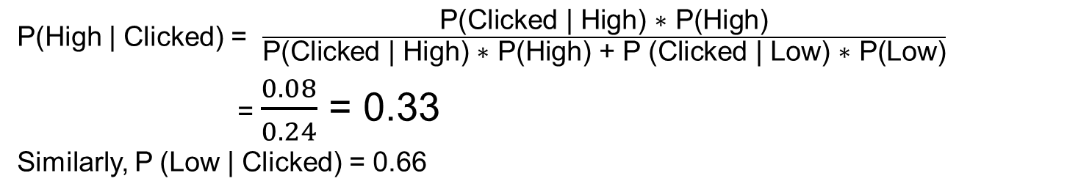
Bayes theorem example – Part 2
Type of customer | Population proportion | Clicked | Didn’t click
High value | 20% | 40% | 60%
Low value | 80% | 20% | 80%
P(High | Clicked) = $\frac{\text{P}\text{(}\text{Clicked}\text{ | }\text{High}\text{) ∗ }\text{P}\text{(}\text{High}\text{)}}{\text{P}\text{(}\text{Clicked}\text{ | }\text{High}\text{) ∗ }\text{P}\text{(}\text{High}\text{) + }\text{P}\text{ (}\text{Clicked}\text{ | }\text{Low}\text{) ∗ }\text{P}\text{(}\text{Low}\text{)}}$
= $\frac{0.08}{0.24}$ = 0.33
Similarly, P (Low | Clicked) = 0.66
Notes:
Discuss the findings
Higher proportion of high value customers click, but number of low value customers are more
In this case, the chance that a customer who clicked is low value is higher than the chance that he is high value
What’s the proportion at which chance of high value will be greater?

Slide 11
Theoretical probability
Theoretical Probability of an event is the number of ways that the event can occur, divided by the total number of outcomes. It is finding the probability of events that come from a sample space of known equally likely outcomes.
Frequentist probability
Experimental probability of an event is the ratio of the number of times the event occurs to the total number of trials
This is called the frequentist approach to probability
Notes:
[10 minutes]
Discuss theoretical vs. experimental probability
Why Experimental Probability?
In real life we don’t know the probability of an event occurring.
We are dealing with uncertainty
What is the probability of the next person walking into the room being a woman?
How do we find out the probability of an event occurring?
We conduct experiments and figure out the long run average
This is inherently related to statistics
Talk about the fact that we don’t know the total outcome space. So we resort to a frequentist understanding – Frequentist probability is always long run
This is the method used in classical statistics
[Catch-Recatch method]

Slide 12
Random variables and Probability distributions
Probability distribution is a function which captures the probabilities of occurrence of all the events of an experiment
Number of people | Random variable - X
<10 | 1
10 to 20 | 2
20 to 30 | 3
30 to 40 | 4
40 to 50 | 5
Random variables are mathematical constructs which help map events to a real number
Notes:
[5 minutes]
How do I get an idea of the probabilities of all possible events in an experiment?
How do I decide which event is most likely to happen?
How do I represent the probability distribution mathematically?
Talk about the fact that random variables are constructs to understand phenomena which could have multiple outcomes [uncertainty]. Each outcome hasa probability of occurring
Ask students to define a probability distribution [Anything which integrates to 1 is a prob distribution] – work out on board
Talk about the fact that many distributions are observed as natural phenomena – Which is why they are used. Anyone can make a probability distribution but it might not represent any real phenomena

Slide 13

Discrete distributions - Bernoulli
Bernoulli distribution has two possible outcomes, success and failure
The distribution is defined by the probability of success (p)
Probability distribution for the outcome of a toss of a coin
Notes:
[5 minutes]
Take examples of Bernoulli trials here:
Did the customer churn?
Did the customer click an ad?
Did a sales lead convert?

Slide 14
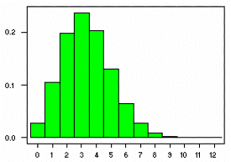
Binomial distribution
Bin(20, 1/6)
Binomial distribution is arrived at by performing ‘n’ successive Bernoulli trials, probability of success in each trial is given by ‘p’
Notes:
[10 minutes]
Go through the example to build intuition around repeated Bernoulli trials
Relate back to the customer churn example – There are many customers and each of them can churn or not churn
Bernoulli distribution tells the probability of different churn levels occurring

Slide 15
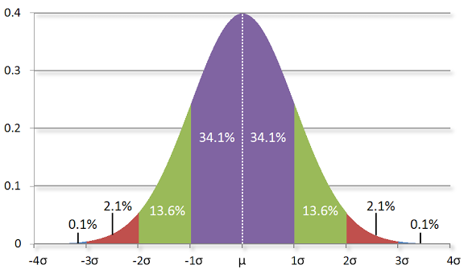
Continuous distributions – Normal distribution
40
Normal distribution is a continuous frequency distribution which is symmetric around the mean
Normal distribution is completely described by mean μ and variance, σ²
μ is the center and σ determines the spread (the larger the σ the more spread the curve is)
30
20
10
68.2%
95.4%
99.7%
Notes:
[5 minutes]
Build the basics of the normal distribution – Talk about how it is fundamental to statistics because of results which you will discuss next
Talk about the characteristics of the distribution
Talk about how to calculate the probability of values given a distribution [White board this] (P(X>2), etc.
Not necessary to spend too much time here at this points. Can come back to this for a bit after sampling distributions

Slide 16
Why sampling?
What is the average age of India?
Population of all Indian people
Random sample
Inferences
Sample mean
Population mean
Notes:
[10 minutes]
Revisit the fundamental problem of decision making under uncertainty
Talk about challenges in defining a population – Who is Indian? – NRIs included? Indian origin?
I want to understand something about a population but I can’t. Challenges include:
I need data on everybody in India
Too time consuming to collect
Typically, the idea is that I can take a sample to understand the population. Talk about estimators, estimates, and population parameters and the differences. Eventually, the idea is to always understand the population parameter
Talk about stratified sampling
Stratification makes sense when you want to understand the parameter across a particular dimension [age, etc]
It makes sure that dimension is adequately represented
Stratification does not improve the estimate [make a ‘representative sample’]. Simple random sampling is still the best way.

Slide 17
Randomization
What is randomization?
The process of selection from the population such that every possible sample has an equal chance of being selected as the sample
This translates to equal chance of every unit of the population having an equal chance of being in the sample
It is the process of generating itself that is random, not the sample itself
What is a ‘representative’ sample?
There is no such thing! It is a misnomer
Though intuitively appealing, a sample can never be truly representative of the population
It can be representative on one dimension, but there are so many unknown dimensions on which it is not representative. How do we know which dimensions? How do we decide?
Notes:
Talk about the importance of randomization [What is randomization?]
Ask what is randomization?
Is it easy to pick random samples? [Have a discussion
Short class activity – Ask people to pick random numbers. Does hearing the previous person’s choice make the subsequent person pick a number further away so that they ensure that it is ‘random’ and ‘representative’. This is a false notion. A sample of {2,3,45} is a valid random sample as long as the ‘process’ of picking the sample was random
It is always the process and not the sample itself which needs to be evaluated
Random means that each sample has an equal chance of being selected as the sample which translates to each unit of the population having an equal chance of being selected into the sample
There is no such thing as a ‘representative’ sample – It could be representative on one dimension but there are 100 other unknown dimensions on which it is not representative
The idea of randomization is to remove bias in the ‘selection’ of the sample

Slide 18
An exercise
Height
168
165
171
173
166
{168, 165, 171}
168
{168, 171, 173}
170.66
{168, 173, 166}
169
{165, 171, 173}
169.66
{168, 165, 173}
168.66
{168, 171, 166}
168.33
{171, 173, 166}
170
{165, 171, 166}
167.33
Population mean = 168.6
{173, 161, 166}
166.66
{168, 165, 166}
166.33
Mean of sample means= 168.463
The mean of the sample means of all samples of a particular size is close to the population mean
Notes:
[10 minutes]
Exercise on sampling distributions and CLT
Ask students to do the exercise – Take multiple samples from the population, take the mean of the sample means and compare it to the population mean
Discuss the implication of the finding
Introduce the idea of a sampling distribution – A distribution of the sample means [Whiteboard this]
So the sampling distribution can be used to understand how confident one can be about an estimated sample mean
Talk about how this is a simulation – In real life, we will almost always one sample, but this result on the sampling distribution helps us associate confidence with the estimate of the sample mean
CLT
Talk about how this is a realization of CLT. What was done is basically what is said in the CLT
Talk about how this is the reason why the Normal distribution is fundamental to statistics – most statistical inference draws from the CLT which allows us to estimate/ validate hypotheses under uncertainty – Segway to the next session

Slide 19
Central Limit Theorem Demo
[Link below] (OR)
R script
Notes:
[5 minutes]
http://onlinestatbook.com/stat_sim/sampling_dist/
Illustrate how the central limit theorem holds even for non-normal population distributions
It only translates to a larger sample size above which the CLT holds
Use R script [first part] or online link
N-1 vs n – Biased estimator

Slide 20
Appendix

Slide 21
Bayes theorem in action – An example
Notes:
[10 minutes]
Go through the real example of Bayes theorem
Run it line by line in R
Discuss and enforce how these ideas of probability help with decision making
[Create a slide for this]

